Slide 1
UNIT-2
MOBILE APPLICATION DEVELOPMENT
Android application components

Slide 2
(MR20-1CS0116) Mobile Application Development
UNIT – I Introduction to Android Operating System:
Android OS and Features – Android development framework; Installing and running applications on Android Studio, Creating AVDs, Types of Android application; Creating Activities, Activity Life Cycle, Activity states, monitoring state changes
UNIT – II Android application components :
Android Manifest file, Externalizing recourses like Simple Values, Drawables, Layouts, Menus, etc. Building User Interfaces: Fundamental Android UI design, Layouts – Linear, Relative, Grid and Table Layouts. User Interface (UI) Components
UNIT – III Fragments :
Creating fragments, Lifecycle of fragments, Fragment states, Adding fragments to Activity, adding, removing and replacing fragments with fragment transactions, interfacing between fragments and Activities,
UNIT – IV Intents and Broadcasts:
Using intents to launch Activities, Types of Intents, Passing data to Intents, Getting results from Activities, Broadcast Receivers – Using Intent filters to service implicit Intents, Resolving Intent filters
UNIT – V Database:
Introduction to SQLite database, creating and opening a database, creating tables, inserting retrieving and deleting data;

Slide 3
Unit 2: Android application components :
Android application components
Android Manifest file
Building User Interfaces
a) Fundamental Android UI design
b) Layouts
i. Linear Layout
ii. Relative Layout
iii. Table and
iv Grid Layout
c) UI Components
3. Externalizing Resources
a) Simple Values – colors.xml, strings.xml
b) Drawables (images)
c) Layouts
d) Menus

Slide 4
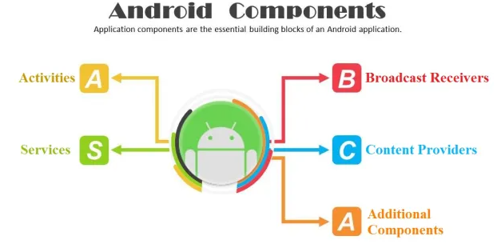
Android application components
Application components are the essential building blocks of an Android application.
These components are loosely coupled by the application manifest file
AndroidManifest.xml that describes each component of the application and how they interact.

Slide 5
There are following four main components that can be used within an Android application:
Components | Description
Activities | They dictate the UI and handle the user interaction to the smartphone screen
Services | They handle background processing associated with an application.
Broadcast Receivers | They handle communication between Android OS and applications.
Content Providers | They handle data and database management issues.

Slide 6
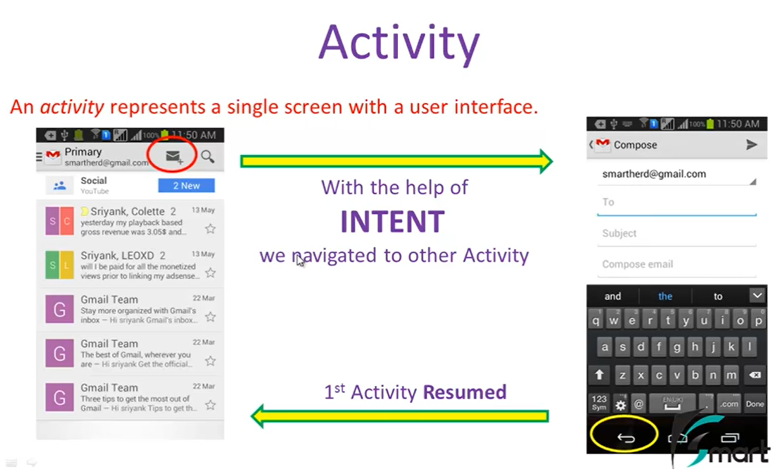
1. Activities
An activity is the entry point for interacting with the user. It represents a single screen with a user interface.
For example, an email app might have one activity that shows a list of new emails, another activity to compose an email, and another activity for reading emails.
An activity facilitates the following key interactions between system and app:
Keeping track of what the user currently cares about
(what is on screen)
Knowing that previously used processes contain things the user may return to (stopped activities)
Providing a way for apps to implement user flows between each other

Slide 7
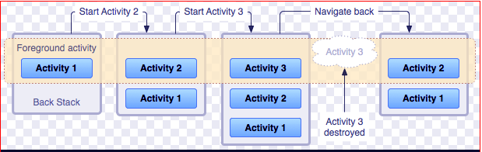
Each activity is independent of one another.
For example – Camera application can be started in an email application to compose an email that shares an image. The picture below depicts how each new activity adds an item to back stack and how the current activity is destroyed and previous activity is resumed.
To implement an activity, extend the Activity class in your subclass:
public class MainActivity extends Activity
{
//code
}

Slide 8
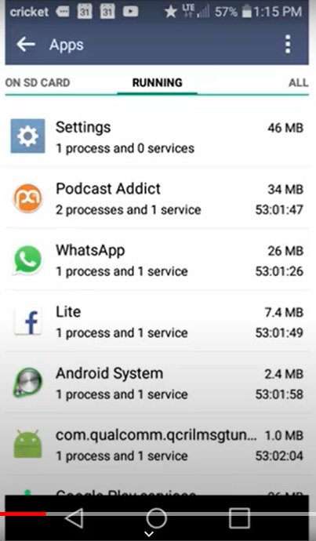
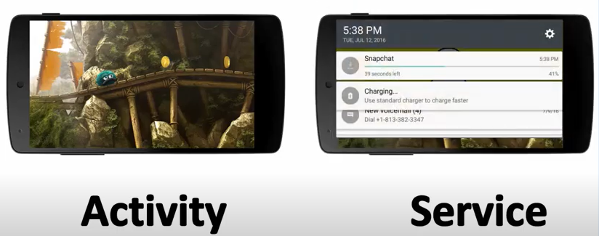
2. Services
A service is a component that runs in the background to perform long-term operations or to perform work for remote processes. it acts as an invisible worker of our application.
It performs tasks when applications are not active.
A service does not provide a user interface.
An example of service is we can surf the internet or use any other application while listening to music.
To execute services, extend the Services class in your sub-class:
public class MyService extends Services
{
//code
}
Playing Game
Downloading SnapChat

Slide 9
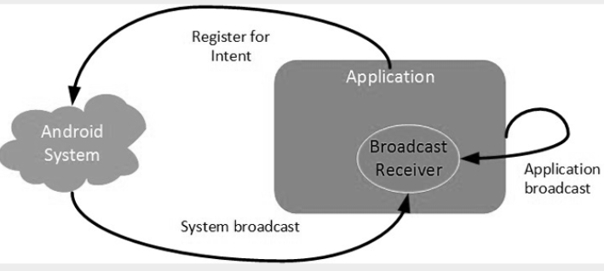
3. Broadcast Receivers
A broadcast receiver is an Android application component which allows you to register for system generated events or application events.
Whenever those events occur the system notifies all the registered broadcast receivers and then the desired action is being done.
Broadcast originates from the system as well as applications. .
The Broadcast Receiver’s job is to pass a notification to the user when a specific event occurs.
Using a Broadcast Receiver, applications can register for a particular type of event. Once the event occurs, the system will notify all the registered applications in the system.
Although broadcast receivers don’t display a user interface, they may create a status bar notification to alert the user when a broadcast event occurs.
Example
The alarm notification, low battery notification etc. are the example of broadcast originating from the system.
While getting the push notifications for desired application describes the example for broadcast originating from the application.

Slide 10
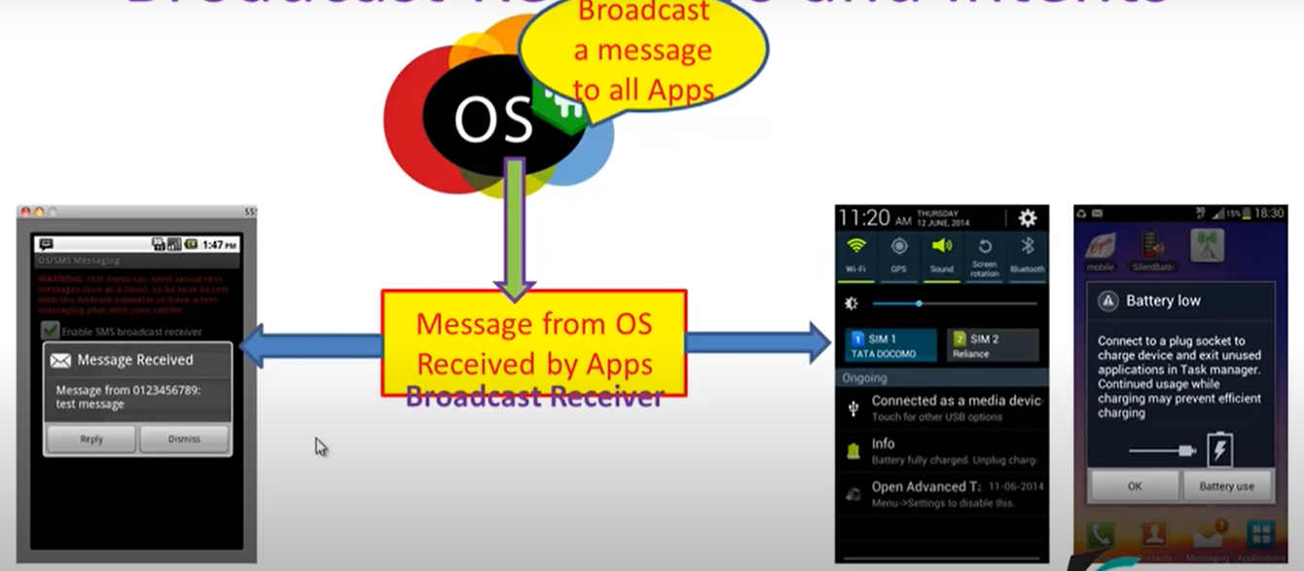
Notification

Slide 11
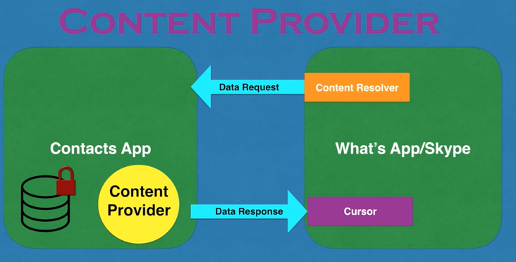
4.Content Providers
Content Provider is a component that allows applications to share data among multiple applications.
It hides the details of the database and can be used to read and write private data of the application which is not shared. It would be a mess to access data from other applications without content providers.
The prime purpose of a content provider is to serve as a central repository of data where users can store and can fetch the data. The access of this repository is given to other applications also but in a safe manner in order to serve the different requirements of the user.
For example, the contacts data is used by multiple applications and must be stored in a content provider.

Slide 12

Additional Components of Android Application
There are additional components which will be used in the construction of above mentioned entities, their logic, and wiring between them. These components are:
Components | Description
Fragments | Represents a behavior or a portion of user interface in an Activity.
Views | UI elements that are drawn onscreen including buttons, lists forms etc.
Layouts | View hierarchies that control screen format and appearance of the views.
Intents | bind individual components to each other at runtime.
Resources | Defining Images, texts, string values. Everything is defined in the resource file and it can be referenced within the source code.
Manifest | Configuration file for the application.

Slide 13
Android Manifest file
The Android Manifest is an XML file which contains important metadata about the Android app.
Every android project that we make, need to have an Android Manifest file within. This file is present in the root of the project source set.
It describes all the important information of the application to the Android build tools.
This includes the package name, activity names, main activity (the entry point to the app), Android version support, hardware features support, permissions, and other configurations
The information that is stored in the Manifest file is as follows:
The name of the application’s package, it is generally the code’s namespace. This information is used to determine the location of the code while building the project.
Another component is the one, that includes all the activities, services, receivers, and content providers.
The permissions that are required by the application to access the protected parts of the system and other apps.
The features required by the app, that affect which devices can install the app from Google Play. These features include both hardware and software features.
It also specifies the application metadata, which includes the icon, version number, themes, etc.

Slide 14
<?xml version="1.0" encoding="utf-8"?> <manifest xmlns:android="http://schemas.android.com/apk/res/android" xmlns:tools="http://schemas.android.com/tools"> <application android:allowBackup="true" android:dataExtractionRules="@xml/data_extraction_rules" android:fullBackupContent="@xml/backup_rules" android:icon="@mipmap/ic_launcher" android:label="@string/app_name" android:roundIcon="@mipmap/ic_launcher_round" android:supportsRtl="true" android:theme="@style/Theme.Week3A" tools:targetApi="31"> <activity android:name=".MainActivity" android:exported="true"> <intent-filter> <action android:name="android.intent.action.MAIN" /> <category android:name="android.intent.category.LAUNCHER" /> </intent-filter> </activity> </application> </manifest>

Slide 15
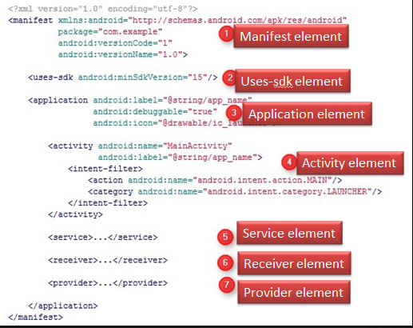
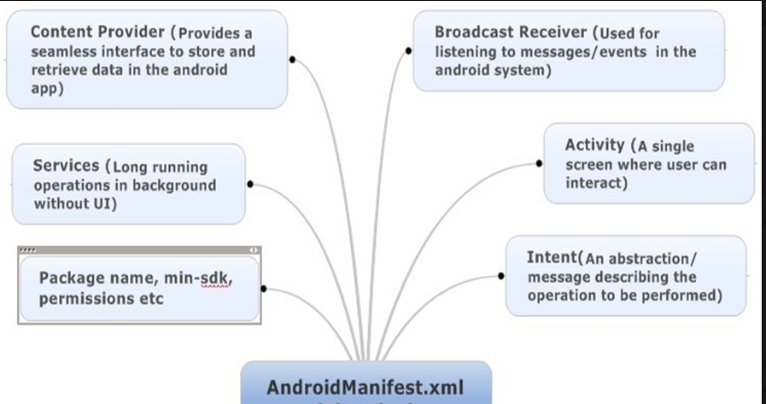

Slide 16
Element Tags of Manifest File
Following are the essential element tags of Manifest.xml files:
1. <manifest> It is the root element of this element. It consists of a package attribute package that tells the activity’s package name.
2. <application> It is the sub-element of the manifest file that includes the declaration of the namespace. It contains certain attributes. These attributes declare the application components, and these attributes include:
android:icon represents the icon for all the android application components.
allowBackup
android:label works as the default label for all the application components.
android:theme represents a common theme for all the android activities.
3. <activity> Activity is a sub-element of application. It has the declaration of the activity that must be there in the manifest file. It also has certain attributes like name, label, theme, etc.
android:label represents a label i.e. displayed on the screen.
android:name represents a name for the activity class. It is required attribute.
4. <intent-filter> It is an element in the activity, it describes the type of intent in which the Android components can respond.

Slide 17
5. <action> This element provides an action for the intent filter. Each intent filter must have at least one action element in it.
6. <category> This element adds the category name in an intent-filter.
7. <service>
This element contains the operations that are provided by libraries or APIs.
Manifest File Application Property Elements
A list of important Application Property Elements in manifest.xml (Sub- Node Elements)
<uses-permission>: This element specifies the Android Manifest permissions that are requested for the purpose of security.
<permission>: This element sets permission to provide access to control for some components of the app.
3. <permission-groups>: This element sets permission to provide access to control for a set of components of the app.
4. <permission-tree>: This element refers to a specific component that is the owner of the set of components.
5. <instrumentation>: This element tells the interaction between the app and the system.
6. <uses-sdk>: This one specifies the compatibility of the app. 7. <uses-configuration>: This element specifies the permissions that are requested for the purpose of security.
8. <uses-feature>: This element specifies one hardware or software feature that is required by the Application.
9. <supports-screen, compatible-screen>: These elements tell the screen size and configuration.

Slide 18
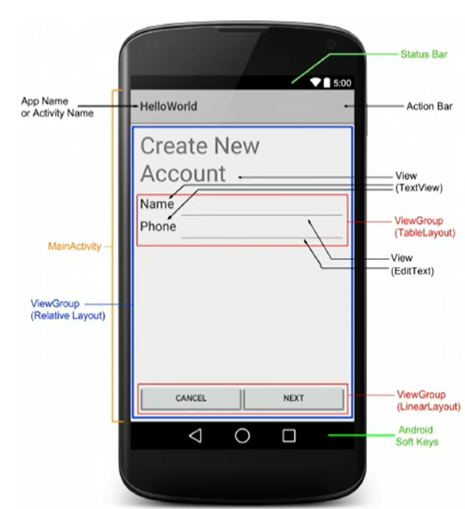
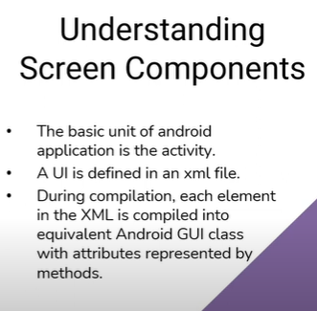
Building User Interfaces -Fundamental Android UI design
User Interface (UI) design in Android is a graphical representation of views displayed on a Smartphone or tablet.
It allows users to interact with the features, functions, and contents of the application. Every application has a user interface with which users can interact. Android provides various pre-built UI components that allow you to build a GUI for your application. Android also provides other UI modules for special interfaces, such as dialogues, notifications, menu, etc.

Slide 19
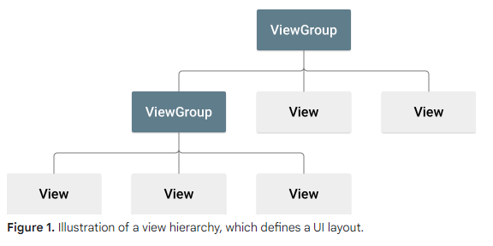
In an Android application, the user interface is built using
View objects
View Group objects.
There are many types of views and view groups, each of which is a descendant of the View class.

Slide 20

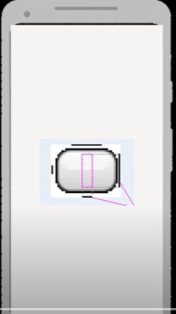
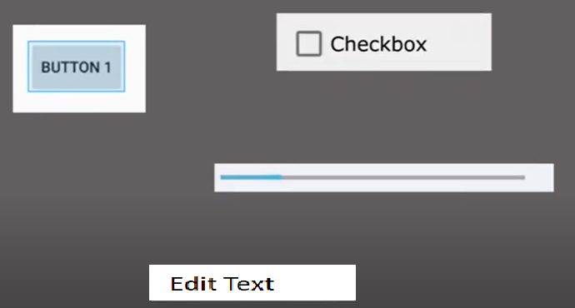
Android SDK Provides build in views

Slide 21
View
• View objects are the basic units of user interface expression on the Android platform.
A View object is a data structure whose properties store the layout parameters and content for a specific rectangular area of the screen consisting of fixed quality of pixel in it.
The View class serves as the base for subclasses called "widgets," which offer fully implemented UI objects, like EditText, Button, CheckBox.
• A View object handles its own measurement, layout, drawing, focus change, scrolling, and key/gesture interactions for the rectangular area of the screen in which it resides.
As an object in the user interface, a View is also a point of interaction for the user and the receiver of the interaction events.
In Android, there are different types of views available, each serving a specific purpose. For example, a TextView is used to display text, a Button is used to trigger actions, and an ImageView is used to display images. These views can be added directly to a layout file or programmatically created and added to the user interface.
Views have their properties and methods that allow developers to customize their appearance and behaviour. For instance, properties like text colour, background colour, and size can be modified to match the desired design. Additionally, views can handle user interactions such as clicks or touches through event listeners.

Slide 22
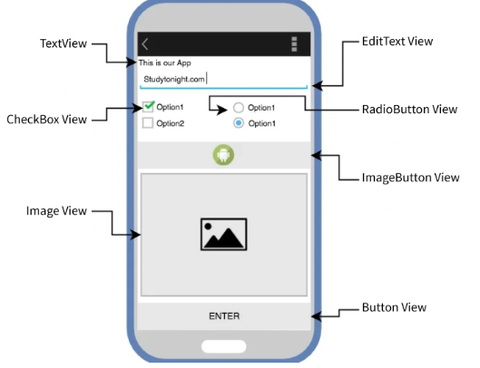
Common View Subclasses

Slide 23
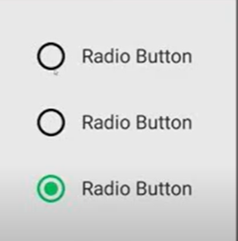
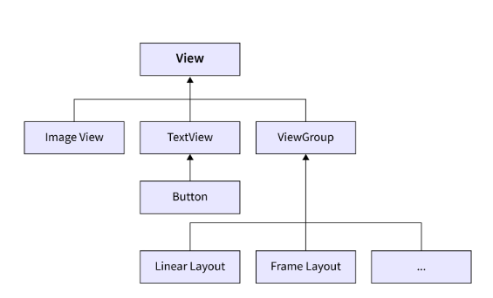
ViewGroup
A View Group is a subclass of the View Class and can be considered as a superclass of Layouts.
A ViewGroup is responsible for containing and arranging multiple View objects within it.
It acts as a container for other Views, allowing you to create complex and dynamic user interfaces.
With ViewGroup, you can organize your app's UI elements in a structured manner.
It provides various layout managers, such as LinearLayout, RelativeLayout, and ConstraintLayout, that determine how Views are positioned and sized within the container. These layout managers offer different ways to arrange Views, whether in a linear fashion, relative to each other, or using constraints.
By using ViewGroup, you can create more responsive and adaptable layouts. It allows you to handle different screen sizes and orientations by adjusting the position and size of Views accordingly.
You can also nest multiple ViewGroups within each other to create hierarchical structures.
In addition to layout management, ViewGroup also provides methods to handle touch events, focus management, and drawing. You can customize the behaviour of your ViewGroup by overriding these methods and implementing your logic.

Slide 24
Layouts
Layout basically refers to the arrangement of elements on a page these elements are likely to be images, texts or styles. These are a part of Android Jetpack. They define the structure of android user interface in the app, like in an activity.
All elements in the layout are built with the help of Views and ViewGroups. These layouts can have various widgets (components) like buttons, labels, textboxes, and many others. Layouts are container views (and, therefore, subclassed from ViewGroup) designed to control how child views are positioned on the screen.
<?xml version="1.0" encoding="utf-8"?>
<LinearLayout android:id="@+id/layout2“
android:layout_width="match_parent“
android:layout_height="match_parent"
android:layout_weight="1“
android:background="#8ED3EB“
android:gravity="center“
android:orientation="vertical" >
<TextView android:id="@+id/textView4“
android:layout_width="match_parent“ android:layout_height="wrap_content“
android:layout_marginLeft="10dp“
android:layout_marginTop="-40dp“
android:fontFamily="@font/almendra_bold"
android:text="This is a TextView" />
</LinearLayout>

Slide 25
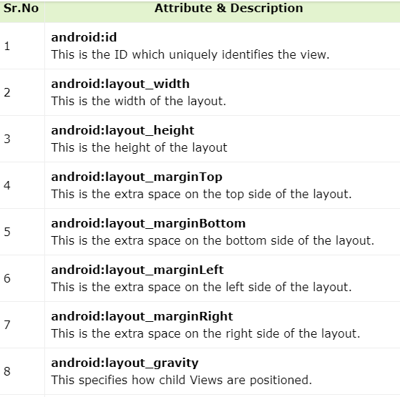
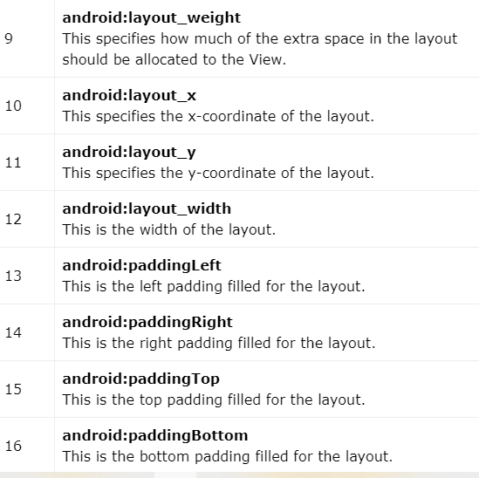
Layout Attributes
Each layout has a set of attributes which define the visual properties of that layout. There are few common attributes

Slide 26
Android Layout Types
The Android SDK includes the following layout views that may be used within an Android user interface design:
1. ConstraintLayout – Introduced in Android 7, this layout manager is recommended for most layout requirements. Constraint Layout allows the positioning and behavior of the views in a layout to be defined by simple constraint settings assigned to each child view. The flexibility of this layout allows complex layouts to be quickly and easily created without the necessity to nest other layout types inside each other, resulting in improved layout performance. Constraint Layout is also tightly integrated into the Android Studio Layout Editor tool.
2. LinearLayout – Positions child views in a single row or column depending on the orientation selected. A weight value can be set on each child to specify how much of the layout space that child should occupy relative to other children.
3. TableLayout – Arranges child views into a grid format of rows and columns. Each row within a table is represented by a TableRow object child, which, in turn, contains a view object for each cell.
4. FrameLayout – The purpose of the FrameLayout is to allocate an area of the screen, typically to display a single view. If multiple child views are added, they will, by default, appear on top of each other and be positioned in the top left-hand corner of the layout area. Alternate positioning of individual child views can be achieved by setting gravity values on each child.
For example, setting a center_vertical gravity value on a child will cause it to be positioned in the vertical center of the containing FrameLayout view.

Slide 27
5. RelativeLayout – The RelativeLayout allows child views to be positioned relative to each other and the containing layout view through the specification of alignments and margins on child views.
For example, child View A may be configured to be positioned in the vertical and horizontal center of the containing RelativeLayout view. View B, on the other hand, might also be configured to be centered horizontally within the layout view but positioned 30 pixels above the top edge of View A, thereby making the vertical position relative to that of View A. The RelativeLayout manager can be helpful when designing a user interface that must work on various screen sizes and orientations.
6. AbsoluteLayout – Allows child views to be positioned at specific X and Y coordinates within the containing layout view. Using this layout is discouraged since it lacks the flexibility to respond to screen size and orientation changes.
7. GridLayout – A GridLayout instance is divided by invisible lines that form a grid containing rows and columns of cells. Child views are then placed in cells and may be configured to cover multiple cells horizontally and vertically, allowing a wide range of layout options to be quickly and easily implemented. Gaps between components in a GridLayout may be implemented by placing a special type of view called a Space view into adjacent cells or setting margin parameters.

Slide 28
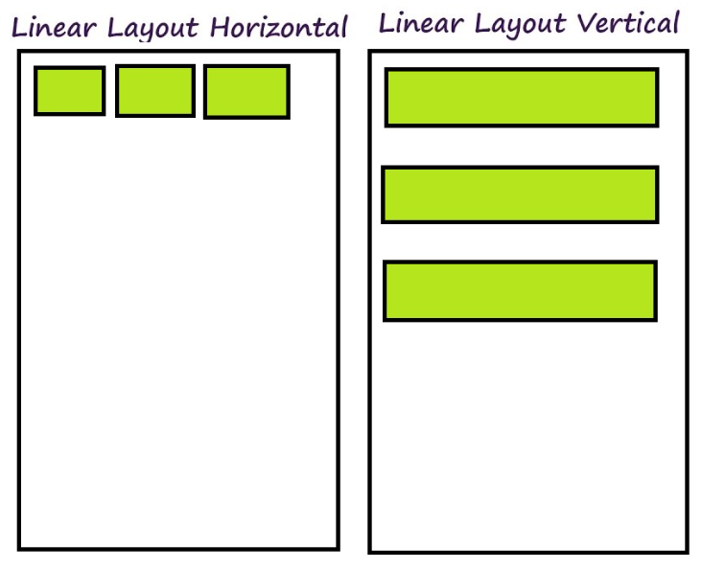
1. Linear Layout
We use this layout to place the elements in a linear manner. A Linear manner means one element per line.
This layout creates various kinds of forms on Android. In this, arrangement of the elements is in a top to bottom manner.
Linear layout is simple and easy to use, it creates a scroll bar if the length of the window exceeds the length of the screen.
Vertically linear layout has only one item per row. Linear layout has many different attributes which can be used to
customize linear layout according to needs.
This can have two orientations: a. Vertical Orientation – It is shown above where the widgets such as TextViews, and all in a vertical manner. b. Horizontal Orientation – It is shown above where the widgets such as TextViews, and all in a horizontal manner.

Slide 29
Attributes of Linear Layout
android:layout_weight | It is defined individually to the child’s views to specify how Linear Layout divides the remaining space amongst the views it contains
android:weightSum | Defines the total weight sum
android:orientation | How the elements should be arranged in the layout. It can be horizontal or vertical.
android:gravity | It specifies how an object should position its content on its X and Y axes. Possible values are – center_vertical, fill, center, bottom, end, etc.
android:layout_gravity | Sets the gravity of the View or Layout relative to its parent. Possible values are – center_vertical, fill, center, bottom, end, etc.
android:baselineAligned | This must be a Boolean value, either “true” or “false” and prevents the layout from aligning its children’s baselines.
android:id | This gives a unique id to the layout.

Slide 30
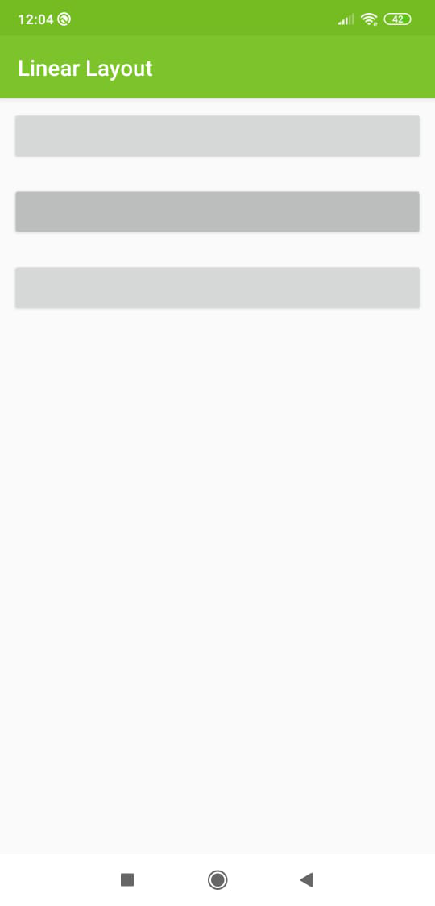
Arrange children views in a vertical manner
<?xml version="1.0" encoding="utf-8"?>
<LinearLayout
xmlns:android="http://schemas.android.com/apk/res/android"
xmlns:app="http://schemas.android.com/apk/res-auto"
xmlns:tools="http://schemas.android.com/tools"
android:layout_width="match_parent"
android:layout_height="match_parent"
android:orientation="vertical"
tools:context=".MainActivity">
<!-- Add vertical in the android:orientation-->
<!-- Add Button-->
<Button
android:layout_width="match_parent"
android:layout_margin="10dp"
android:layout_height="wrap_content"/>
<!-- Add Button-->
<Button
android:layout_width="match_parent"
android:layout_margin="10dp"
android:layout_height="wrap_content"/>
<!-- Add Button-->
<Button
android:layout_width="match_parent"
android:layout_margin="10dp"
android:layout_height="wrap_content"/>
</LinearLayout>

Slide 31
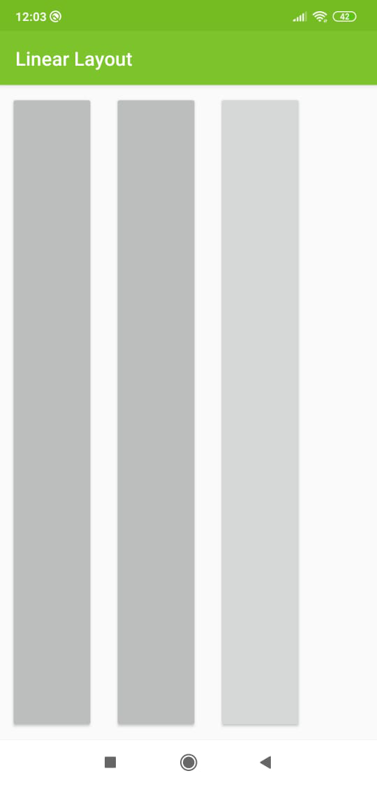
Arrange children views in a horizontal manner
<?xml version="1.0" encoding="utf-8"?>
<LinearLayout
xmlns:android="http://schemas.android.com/apk/res/android"
xmlns:tools="http://schemas.android.com/tools"
android:layout_width="match_parent"
android:layout_height="match_parent"
android:orientation="horizontal"
tools:context=".MainActivity">
<!-- Add horizontal in the android:orientation-->
<!-- Add Button-->
<Button
android:layout_width="wrap_content"
android:layout_height="match_parent"
android:layout_margin="10dp" />
<!-- Add Button-->
<Button
android:layout_width="wrap_content"
android:layout_height="match_parent"
android:layout_margin="10dp" />
<!-- Add Button-->
<Button
android:layout_width="wrap_content"
android:layout_height="match_parent"
android:layout_margin="10dp" />
</LinearLayout>

Slide 32
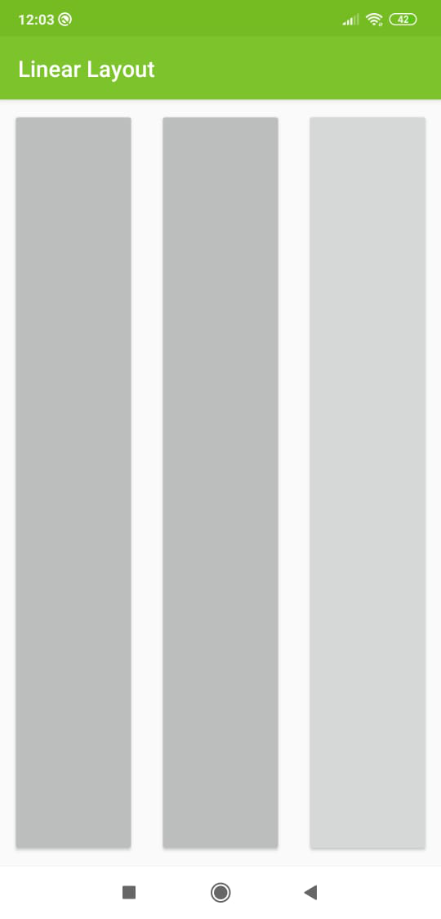
How to use layout_weight and weightSum?
<?xml version="1.0" encoding="utf-8"?>
<LinearLayout
xmlns:android="http://schemas.android.com/apk/res/android"
xmlns:tools="http://schemas.android.com/tools"
android:layout_width="match_parent"
android:layout_height="match_parent"
android:orientation="horizontal"
android:weightSum="3"
tools:context=".MainActivity">
<!-- Add value in the android:weightSum-->
<!-- Add horizontal in the android:orientation-->
<!-- Add Button-->
<!-- Add value in the android:layout_weight-->
<Button
android:layout_width="wrap_content"
android:layout_height="match_parent"
android:layout_margin="10dp"
android:layout_weight="1" />
<!-- Add Button-->
<!-- Add value in the android:layout_weight-->
<Button
android:layout_width="wrap_content"
android:layout_height="match_parent"
android:layout_margin="10dp"
android:layout_weight="1" />
<!-- Add Button-->
<!-- Add value in the android:layout_weight-->
<Button
android:layout_width="wrap_content"
android:layout_height="match_parent"
android:layout_margin="10dp"
android:layout_weight="1" />
</LinearLayout>

Slide 33
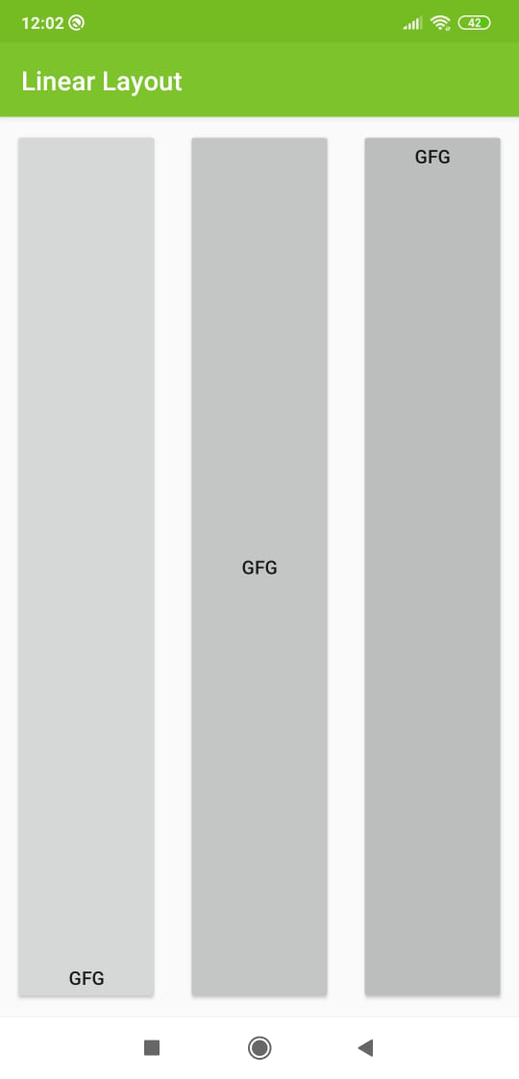
How to use gravity?
<?xml version="1.0" encoding="utf-8"?>
<LinearLayout
xmlns:android="http://schemas.android.com/apk/res/android"
xmlns:tools="http://schemas.android.com/tools"
android:layout_width="match_parent"
android:layout_height="match_parent"
android:orientation="horizontal"
android:weightSum="3"
tools:context=".MainActivity">
<!-- Add value in the android:weightSum-->
<!-- Add horizontal in the android:orientation-->
<!-- Add Button-->
<!-- Add value in the android:gravity -->
<Button
android:layout_width="wrap_content"
android:layout_height="match_parent"
android:layout_margin="10dp"
android:layout_weight="1"
android:gravity="bottom|center"
android:text="GFG" />
<!-- Add Button-->
<!-- Add value in the android:gravity -->
<Button
android:layout_width="wrap_content"
android:layout_height="match_parent"
android:layout_margin="10dp"
android:layout_weight="1"
android:gravity="center"
android:text="GFG" />
<!-- Add Button-->
<!-- Add value in the android:gravity -->
<Button
android:layout_width="wrap_content"
android:layout_height="match_parent"
android:layout_margin="10dp"
android:layout_weight="1"
android:gravity="center|top"
android:text="GFG" />
</LinearLayout>

Slide 34
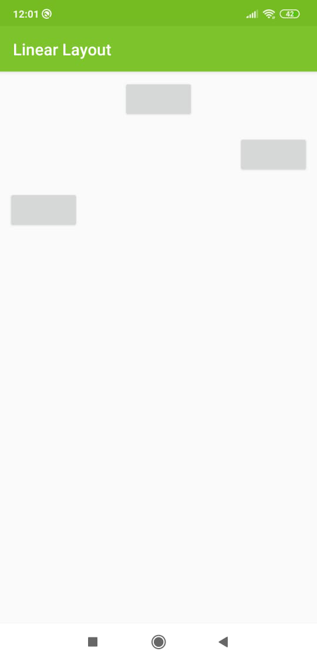
How to use layout_gravity?
<?xml version="1.0" encoding="utf-8"?>
<LinearLayout
xmlns:android="http://schemas.android.com/apk/res/android"
xmlns:tools="http://schemas.android.com/tools"
android:layout_width="match_parent"
android:layout_height="match_parent"
android:orientation="vertical"
tools:context=".MainActivity">
<!-- Add vertical in the android:orientation-->
<!-- Add Button-->
<!-- Add value in the layout_gravity -->
<Button
android:layout_width="wrap_content"
android:layout_height="wrap_content"
android:layout_gravity="center"
android:layout_margin="10dp" />
<!-- Add Button-->
<!-- Add value in the layout_gravity -->
<Button
android:layout_width="wrap_content"
android:layout_height="wrap_content"
android:layout_gravity="right"
android:layout_margin="10dp" />
<!-- Add Button-->
<!-- Add value in the layout_gravity -->
<Button
android:layout_width="wrap_content"
android:layout_height="wrap_content"
android:layout_gravity="left"
android:layout_margin="10dp" />
</LinearLayout>

Slide 35
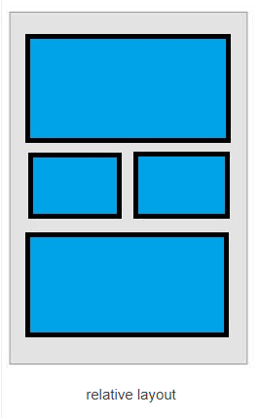
2. Relative Layout
This layout is for specifying the position of the elements in relation to the other elements that are present there.
In Relative Layout, you can use attributes “above, below, left and right” to arrange the child view’s position in relation to other child view components.
The position of each view can be specified as relative to Parent elements or relative to the Child elements. RelativeLayout is the most used layout after LinearLayout in android because RelativeLayout can be used to position our views based on the relative or sibling component’s position.
To define alignment of the position of the
elements to the parent container
android:layout_alignParentTop= “true”
android:layout_alignParentLeft= “true”
The above code, the element will get aligned on
the top left of the parent container.
If we want to align it with some other element in the same container
android:layout_alignLeft= “@+id/element_name”
android:layout_below= “@+id/element_name”
This will align the element below the other element to its left.

Slide 36
There are so many properties that are supported by relative layout.
Some of the most used properties are listed below.
layout_alignParentTop
layout_alignParentBottom
layout_alignParentRight
layout_alignParentLeft
layout_centerHorozontal
layout_centerVertical
layout_above
layout_below

Slide 37
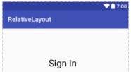
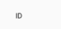
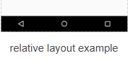
<?xml version="1.0" encoding="utf-8"?> <RelativeLayout xmlns:android="http://schemas.android.com/apk/res/android" xmlns:app="http://schemas.android.com/apk/res-auto" xmlns:tools="http://schemas.android.com/tools" android:layout_width="match_parent" android:layout_height="match_parent" android:layout_margin="20dp" tools:context=".MainActivity">
<TextView
android:id="@+id/textView"
android:layout_width="wrap_content"
android:layout_height="wrap_content"
android:layout_alignParentLeft="true"
android:layout_alignParentStart="true"
android:layout_alignParentTop="true"
android:layout_marginLeft="141dp"
android:layout_marginStart="141dp"
android:layout_marginTop="89dp"
android:text="Sign In“
android:textSize="28sp" />
<TextView
android:id="@+id/textView2"
android:layout_width="wrap_content"
android:layout_height="wrap_content"
android:layout_marginTop="43dp"
android:text="ID“
android:textSize="18sp"
android:typeface="normal"
android:layout_below="@+id/textView"
android:layout_alignLeft="@+id/textView"
android:layout_alignStart="@+id/textView"
android:layout_marginLeft="10dp"
android:layout_marginStart="10dp" />

Slide 38
3. Table Layout
In Android, Table Layout is used to arrange the group of views into rows and columns.
Table Layout containers do not display a border line for their columns, rows or cells.
A Table will have as many columns as the row with the most cells.
For building a row in a table we will use the <TableRow> element. Table row objects are the child views of a table layout.
Each row of the table has zero or more cells and each cell can hold only one view object like Image View, TextView or any other view.
Total width of a table is defined by its parent container
There is no need to mention number of columns in a TableLayout because Android automatically adds columns as per the number of views and other layouts added in a table row.
Column can be both stretchable and shrinkable. If shrinkable then the width of column can be shrunk to fit the table into its parent object and if stretchable then it can expand in width to fit any extra space available.

Slide 39
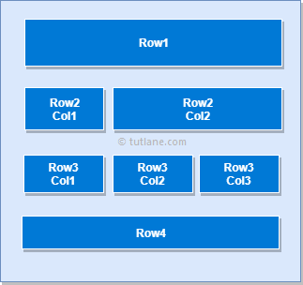
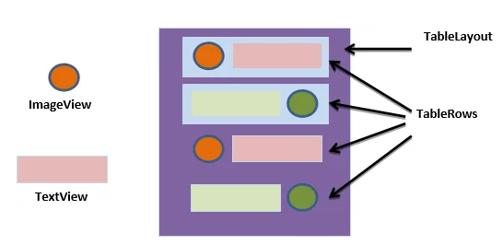
Following is the pictorial representation of table layout in android applications.
<TableLayout xmlns:android="http://schemas.android.com/apk/res/android"
android:layout_width="match_parent"
android:layout_height="match_parent"
<TableRow android:id="@+id/row1"
android:layout_width="fill_parent"
android:layout_height="wrap_content"> <!-- Add elements/columns in the first row->
<TextView android:id="@+id/simpleTextView"
android:layout_width="wrap_content"
android:layout_height="wrap_content“
android:text="Text 1"
android:textColor="#000"
android:textSize="12dp" />
</TableRow>
</TableLayout>

Slide 40
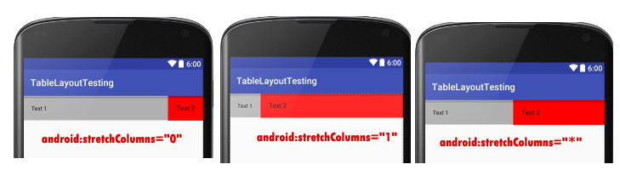
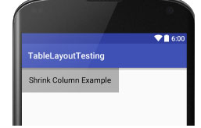
Some of the common attributes used in TableLayout.
Attributes | Where it is used | Why it is used
android:stretchColumns | TableLayout | To change the default width of a column which is set equal to the width of the widest column but we can also stretch the columns to take up available free space by using this attribute. The value that assigned to this attribute can be a single column number or a comma delimited list of column numbers (1, 2, 3…n). If the value is 1 then the second column is stretched to take up any available space in the row, because of the column numbers are started from 0. If the value is 0,1 then both the first and second columns of table are stretched to take up the available space in the row. If the value is ‘*’ then all the columns are stretched to take up the available space.
android:shrinkColumns | TableLayout | When you do not need the extra space in a column, you can use this attribute to shrink and remove the space.
<TableLayout xmlns:android="http://schemas.android.com/apk/res/android" android:layout_width="match_parent" android:layout_height="match_parent" android:shrinkColumns="0">

Slide 41
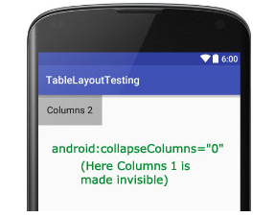
android:collapseColumns | TableLayout | It hides the column of the given index in the TableLayout. The index value starts from 0 i.e the first column will have index 0
<TableLayout xmlns:android="http://schemas.android.com/apk/res/android" android:layout_width="match_parent" android:layout_height="match_parent" android:collapseColumns="0">
<TableRow android:id="@+id/simpleTableLayout" android:layout_width="fill_parent"
android:layout_height="wrap_content">
<TextView android:layout_width="wrap_content" android:layout_height="wrap_content“
android:text="Columns 1“/>
<TextView android:layout_width="wrap_content"
android:layout_height="wrap_content“
android:text="Columns 2“/>
</TableRow> </TableLayout>

Slide 42
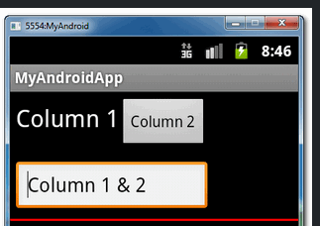
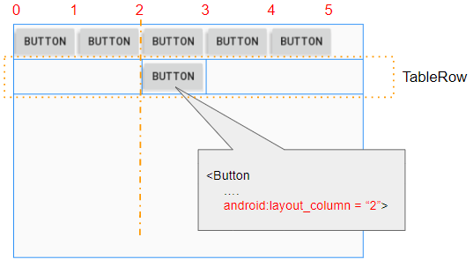
android:layout_span | Any View inside the Table Row | If a view takes only one column width but when you want your view to take more than one column space, then you can use this attribute.
android:layout_column | Any view inside the TableRow | When you want your view present in the first TableRow to appear below the other TableRow's view, you can use this attribute.
<TableRow android:id="@+id/tableRow1" android:layout_width="wrap_content" android:layout_height="wrap_content“ >
<TextView android:id="@+id/textView1"
android:text="Column 1“ />
<Button android:id="@+id/button1"
android:text="Column 2" />
</TableRow>
<TableRow android:id="@+id/tableRow2" android:layout_width="wrap_content" android:layout_height="wrap_content"
>
<EditText android:id="@+id/editText1"
android:layout_span="2"
android:text="Column 1 & 2" />
</TableRow>

Slide 43
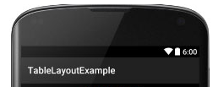
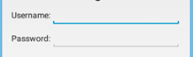
Example:
<TableRow
android:layout_width="match_parent" android:layout_height="match_parent" >
<TextView
android:id="@+id/tvPassword" android:layout_width="wrap_content" android:layout_height="wrap_content" android:text=“Password />
<EditText android:id="@+id/etPassword" android:layout_width="wrap_content" android:layout_height="wrap_content" android:layout_weight="1"
android:inputType="textPassword" /> </TableRow>
<?xml version="1.0" encoding="utf-8"?>
<TableLayout xmlns:android=http://schemas.android.com/apk/res/android
xmlns:tools=http://schemas.android.com/tools
android:layout_width="match_parent“
android:layout_height="match_parent“
android:padding=“16dp“
android:stretchColumns="*" >
<TableRow
android:layout_width="match_parent“
android:layout_height="match_parent" >
<TextView android:id="@+id/tvUsername“
android:layout_width="wrap_content“
android:layout_height="wrap_content“
android:text=“UserName" />
<EditText android:id="@+id/etUsername"
android:layout_width="wrap_content“
android:layout_height="wrap_content"
android:inputType="textPersonName“
android:layout_weight="1" />
</TableRow>

Slide 44
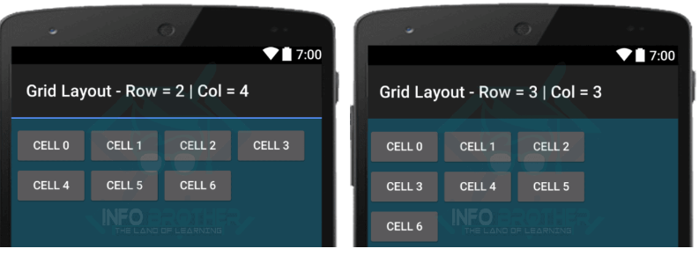
3. Grid Layout
GridLayout basically places its children in a rectangular grid. This grid has a set of a number of thin lines that separate the view area into cells. Suppose you have a grid of N columns, then we will have N+1 grid indices that would be starting from 0..
Grid Layout is just like the Table Layout with the difference that in the TableLayout , rows and columns are added dynamically as you build the table. With the GridLayout , row and column sizes are defined in the layout definition.
This grid provides the flexibility to line up elements along the virtual grid lines created while bilding a view with grid layout.
syntax to declare Grid Layout
<GridLayout xmlns:android="http://schemas.android.com/apk/res/android" android:layout_width="match_parent" android:layout_height="match_parent"
android:rowCount="2"
android:columnCount="2">
<Button android:text="Cell 0" android:textSize="14dip" />
<Button android:text="Cell 1" android:textSize="14dip" />
</GridLayout>
The number of rows and columns within the grid can be declared using the android:rowCount and android:columnCount properties.

Slide 45
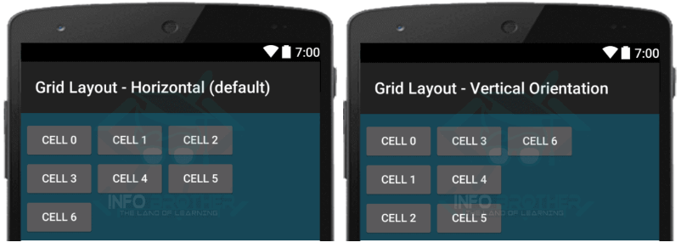
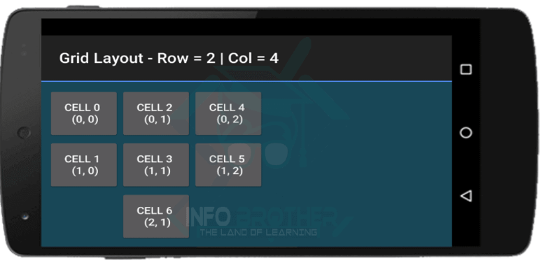
SPECIFYING POSITION:
In Grid layout, we add views and the layout arrange the views in order (Left to Right). However if we want to Explicitly control the positions of the child views in Grid layout, we can do it by just using Layout row and columns attributes
<GridLayout xmlns:android="http://schemas.android.com/apk/res/android" android:layout_width="match_parent" android:layout_height="match_parent" android:padding="10dp“ android:rowCount="3" android:columnCount="3">
<Button android:text="Cell0"
android:textSize="14dip"
android:padding="20dp" android:layout_row="0" android:layout_column="0" />
<Button android:text=“Cell1" android:textSize="14dip" android:padding="20dp" android:layout_row="1" android:layout_column="0" />
SPECIFYING ORIENTATION:
The Grid Layout Organise the Childs views either Horizontally or vertically based on the specified Orientation Property. Grid layout will Position each child view in Default Orientation that is Horizontal (from left to right). we Change the Orientation from default, which is Horizontal to Vertical Orientation

Slide 46
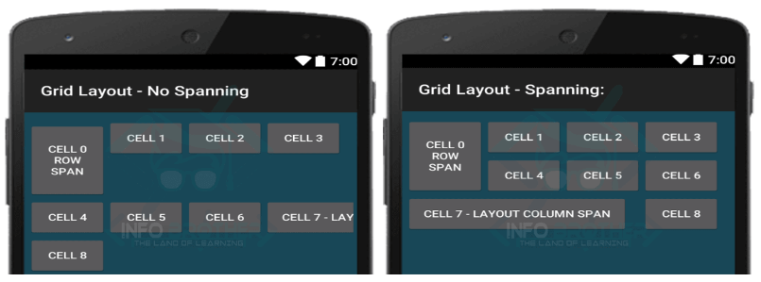
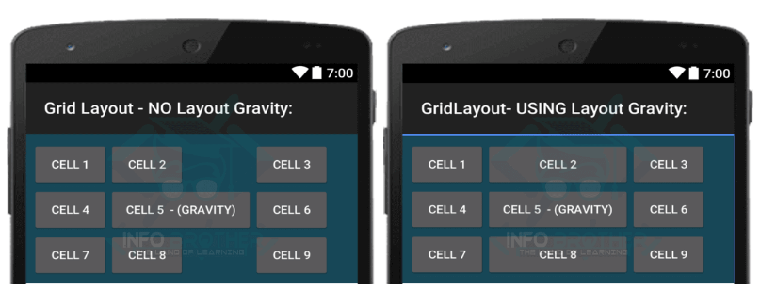
USING LAYOUT GRAVITY:
Grid Layout use a different layout model. its wrap the content and provide enough space to cell that required by element.
In this case, if the first cell in the column contain a small element and second cell in same column contain something bigger, than second cell will stretched itself to provide enough space to element. But other all cells will be at same size and cannot stretch itself. so, to control this situation, we use Layout Gravity attribute
ROWS & COLUMNS SPAN:
In Grid layout, we can also span Multiple rows or columns. Consider the following example Where the first Cell (Cell 0) span 2 Rows and the Seven ^{th} cell span three columns
<Button android:text="Cell 2"
android:textSize="14dip"
android:padding="20dp"
android:layout_gravity="fill_horizontal" />

Slide 47
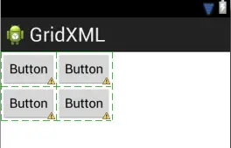
Example:
<GridLayout xmlns:android="http://schemas.android.com/apk/res/android" xmlns:tools="http://schemas.android.com/tools"
android:id="@+id/GridLayout1"
android:layout_width="wrap_content"
android:layout_height="wrap_content"
android:columnCount="2"
android:rowCount="2"
android:orientation="horizontal“
tools:context=".GridXMLActivity" >
<Button
android:id="@+id/button1“
android:layout_gravity="left|top“
android:text="Button" />
<Button
android:id="@+id/button2"
android:layout_gravity="left|top"
android:text="Button" />
<Button
android:id="@+id/button3“
android:layout_gravity="left|top“
android:text="Button" />
<Button
android:id="@+id/button4“
android:layout_gravity="left|top"
android:text="Button" />
</GridLayout>

Slide 48
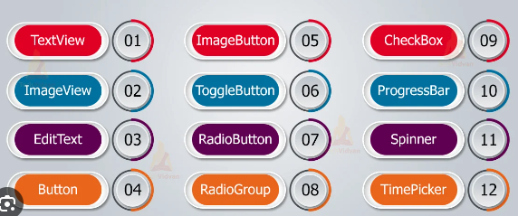
UI Components / UI Controls

Slide 49
Sr. No. | UI Control & Description
1 | TextView This control is used to display text to the user.
2 | EditText EditText is a predefined subclass of TextView that includes rich editing capabilities.
3 | Button A push-button that can be pressed, or clicked, by the user to perform an action.
4 | ImageButton An ImageButton is an AbsoluteLayout which enables you to specify the exact location of its children. This shows a button with an image (instead of text) that can be pressed or clicked by the user.
5 | CheckBox An on/off switch that can be toggled by the user. You should use check box when presenting users with a group of selectable options that are not mutually exclusive.
6 | ToggleButton An on/off button with a light indicator.

Slide 50
7 | RadioButton The RadioButton has two states: either checked or unchecked.
8 | RadioGroup A RadioGroup is used to group together one or more RadioButtons.
9 | ProgressBar The ProgressBar view provides visual feedback about some ongoing tasks, such as when you are performing a task in the background.
10 | Spinner A drop-down list that allows users to select one value from a set.
11 | TimePicker The TimePicker view enables users to select a time of the day, in either 24-hour mode or AM/PM mode.
12 | DatePicker The DatePicker view enables users to select a date of the day.

Slide 51
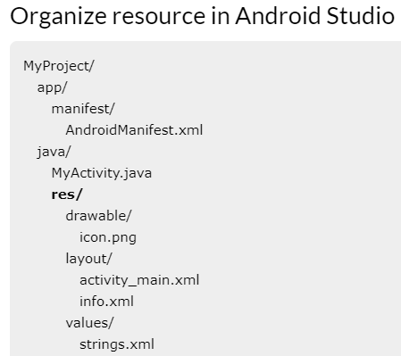
External Resources in Android
It's always good practice to keep non-code resources like images and string constants external to your code.
Android supports the externalization of resources ranging from simple values such as strings and colors to more complex resources like images (Drawables), animations, and themes.
These resources are always maintained separately in various sub-directories under res/ directory of the project.
You should also provide alternative resources for specific device configurations, by grouping them in specially-named resource directories.
At runtime, Android uses the appropriate resource based on the current configuration. For example, you might want to provide a different UI layout depending on the screen size or different strings depending on the language setting.

Slide 52
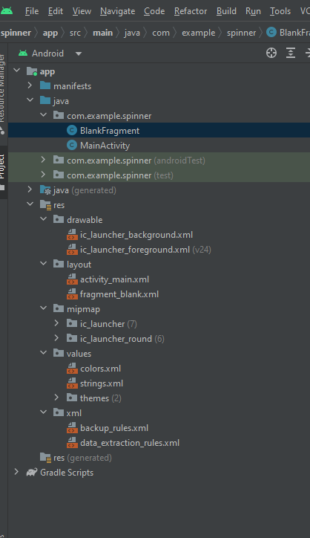

Slide 53
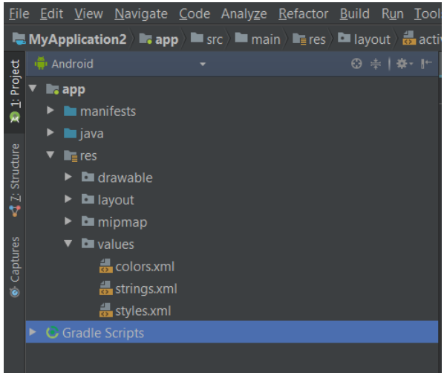
Simple Values – colors.xml, strings.xml
String.xml file contains all the strings which will be used frequently in Android project.
String.xml file present in the values folder which is sub folder of res folder in project structure.
In Android Studio, we have many Views such as TextView,Button,EditText,CheckBox,RadioButton etc. These views have a common attribute named text. we can assign value to this attribute directly or via string.xml.
In large applications, we use some text many times in our project so rather than define that particular text many times. it is best to store in string.xml file and call it by its string name in project.
For example: Suppose we have a text:- “Hey How are You”
and print them many times
Best way is to store this text in string.xml once and call string wherever required. This will save a lot of efforts and less line of code.

Slide 54
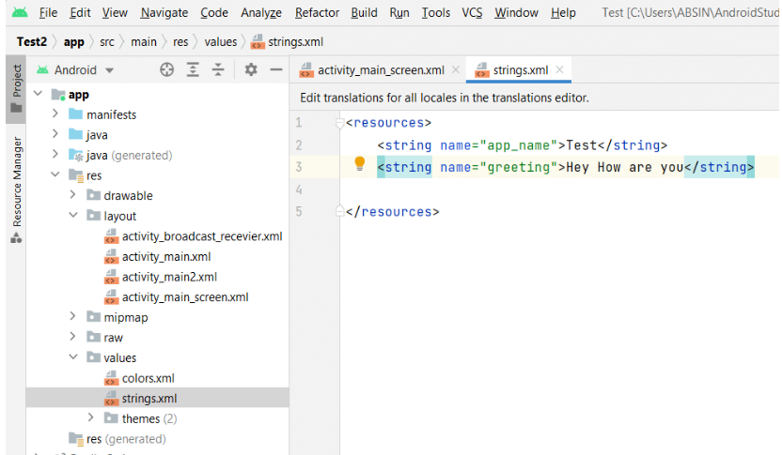
Step 1
Go to String.xml file (app->res->values->strings.xml)
Step 2
Now define a String in string.xml.​

Slide 55

Step 3
Now Go to layout XML file and added this code .Here we call this string by using @string/greeting.
<?xml version="1.0" encoding="utf-8"?>
<LinearLayout
xmlns:android="http://schemas.android.com/apk/res/android"
xmlns:app="http://schemas.android.com/apk/res-auto"
xmlns:tools="http://schemas.android.com/tools"
android:layout_width="match_parent"
android:layout_height="match_parent"
android:orientation="vertical"
tools:context=".MainActivity">
<TextView
android:layout_width="wrap_content"
android:layout_height="wrap_content"
android:text="@string/greeting"
android:textSize="30dp"/>
<TextView
android:layout_width="wrap_content"
android:layout_height="wrap_content"
android:text="@string/greeting"
android:textSize="30dp"/>
<TextView
android:layout_width="wrap_content"
android:layout_height="wrap_content"
android:text="@string/greeting"
android:textSize="30dp"/>
</LinearLayout>

Slide 56
How can we use String Array ?
Activity_main.xml
Step1
Go to String.xml and add the below xml code
inside the <resource></resource> tag.
<LinearLayout xmlns:android="http://schemas.android.com/apk/res/android"
xmlns:app="http://schemas.android.com/apk/res-auto"
xmlns:tools="http://schemas.android.com/tools"
android:layout_width="match_parent"
android:layout_height="match_parent"
tools:context=".MainActivity"
android:orientation="vertical"
android:padding="20dp">
<Spinner
android:id="@+id/spinner"
android:layout_width="227dp"
android:layout_height="97dp"
android:entries="@array/country" />
<TextView
android:id="@+id/tv"
android:layout_width="285dp"
android:layout_height="198dp"
android:text="TextView"
android:padding="20dp"
android:layout_marginTop="50dp"/>
</LinearLayout>
String.xml
<string-array name=“country">
<item>India</item>
<item>USA</item>
<item>Africa</item>
<item>Norway</item>
</string-array>

Slide 57
mainActivity.java
public class MainActivity extends AppCompatActivity implements AdapterView.OnItemSelectedListener
{
@Override
protected void onCreate(Bundle savedInstanceState) {
super.onCreate(savedInstanceState);
setContentView(R.layout.activity_main);
Spinner sp = findViewById(R.id.spinner);
sp.setOnItemSelectedListener(this);
}
@Override
public void onItemSelected(AdapterView<?> adapterView, View view, int i, long l)
{
TextView tvobj =findViewById(R.id.tv);
String txt = adapterView.getItemAtPosition(i).toString();
tvobj.setText(txt);
}
@Override
public void onNothingSelected(AdapterView<?> adapterView) {
}

Slide 58
colors.xml
The colors.xml file is responsible to hold all the types of colors required for the application. It may be primary brand color and its variants and secondary brand color and its variants. The colors help uphold the brand of the applications.
The colors need to be defined in the hex code format.
We can define some colors in a resource file, then apply those colors elsewhere in our app. By convention, colors are defined in a colors.xml file. Colors are considered “value
Add the below lines inside the colors.xml file.
<color name="colorPrimary">#6200EE</color>
<color name="colorPrimaryDark">#3700B3</color>
<color name="colorAccent">#03DAC5</color>
<color name="green">#0F9D58</color>
<color name="cool">#188FCF</color>
<color name="warm">#F1D416</color>

Slide 59


activity_main.xml file
MainActivity.java file
<RelativeLayout
xmlns:android="http://schemas.android.com/apk/res/android"
xmlns:tools="http://schemas.android.com/tools"
android:id="@+id/rlVar1"
android:layout_width="match_parent"
android:layout_height="match_parent"
android:background="@color/green"
tools:context=".MainActivity">
<Button
android:id="@+id/btVar1"
android:layout_width="150dp"
android:layout_height="wrap_content"
android:padding="20dp"
android:text="Cool"
android:textSize="25dp"
android:onClick=change()/>
RelativeLayout>
public class MainActivity extends AppCompatActivity {
@Override
protected void onCreate(Bundle savedInstanceState) {
super.onCreate(savedInstanceState);
setContentView(R.layout.activity_main);
RELayout = findViewById(R.id.rlVar1);
public void change(View view)
{
// set the color to relative layout
RELayout.setBackgroundResource(R.color.cool);
}

Slide 60
Drawable Folder
When you need to display static images in your app, you can use the Drawable class and its subclasses to draw shapes and images.
You can add graphics to your app by referencing an image file from your project resources. Supported file types are PNG (preferred), JPG (acceptable), and GIF (discouraged). App icons, logos, and other graphics, such as those used in games, are well suited for this technique.
To use an image resource, add your file to the res/drawable/ directory of your project. Once in your project, you can reference the image resource from your code or your XML layout.

Slide 61
How to add image in an application?
Right click on the drawable folder and select paste option.
<?xml version="1.0" encoding="utf-8"?> <RelativeLayout xmlns:android="http://schemas.android.com/apk/res/android" xmlns:tools="http://schemas.android.com/tools" android:layout_width="match_parent" android:layout_height="match_parent" tools:context=".MainActivity"> <ImageView android:src="@drawable/flower" android:layout_centerVertical="true" android:layout_centerHorizontal="true" android:layout_width="wrap_content" android:layout_height="wrap_content"> </ImageView>
</RelativeLayout>

Slide 62

Output:

